Slide 1
SOLIDIFY YOUR TEST AUTOMATION !!!
<p> Design Principles for Test Engineers. </p>

Slide 2
Welcome
Audience Introduction

Slide 3

HELLO! I’m…
<p> George T Jose </p>
12 years in the Tech World!
Currently enjoying and learning as a Software Developer.
Passionate about clean code and making tests awesome!

Slide 4
What's on the Menu Today?
01
02
03
04
05
06
Why bother with SOLID at all🤔?
Meet the SOLID Family 🏠
Understand SOLID with Generic Example🧩
SOLID in Action: Real-Life Test Use Cases 🎬
Makeover Time: Refactoring Fun 🛠️
Let's Chat : Questions and Answers

Slide 5
Why bother with SOLID?
01
<p> When foundational design principles like SOLID are ignored. Things can get become difficult. </p>

Slide 6


Do you want to live in this house?

Slide 7
SOLID Principle USES?
<p> Advantages. </p>
🏗️ Builds Scalable and Easy-to-Maintain Tests
🚀 Reduces Test "Tech Debt“
🐞 Simplifies Debugging
🤝 Better Team Collaboration

Slide 8
MEET THE SOLID FAMILY
02
<p> Here were are going to see the different SOLID principles and its brief detail</p>

Slide 9
Understand SOLID with Generic Examples
03
<p> Generic Examples and Demos </p>

Slide 10
SOLID in Action: Real-Life Test Use Cases
04
<p> Here were are going to see the different SOLID principles and its use cases in Test </p>

Slide 11
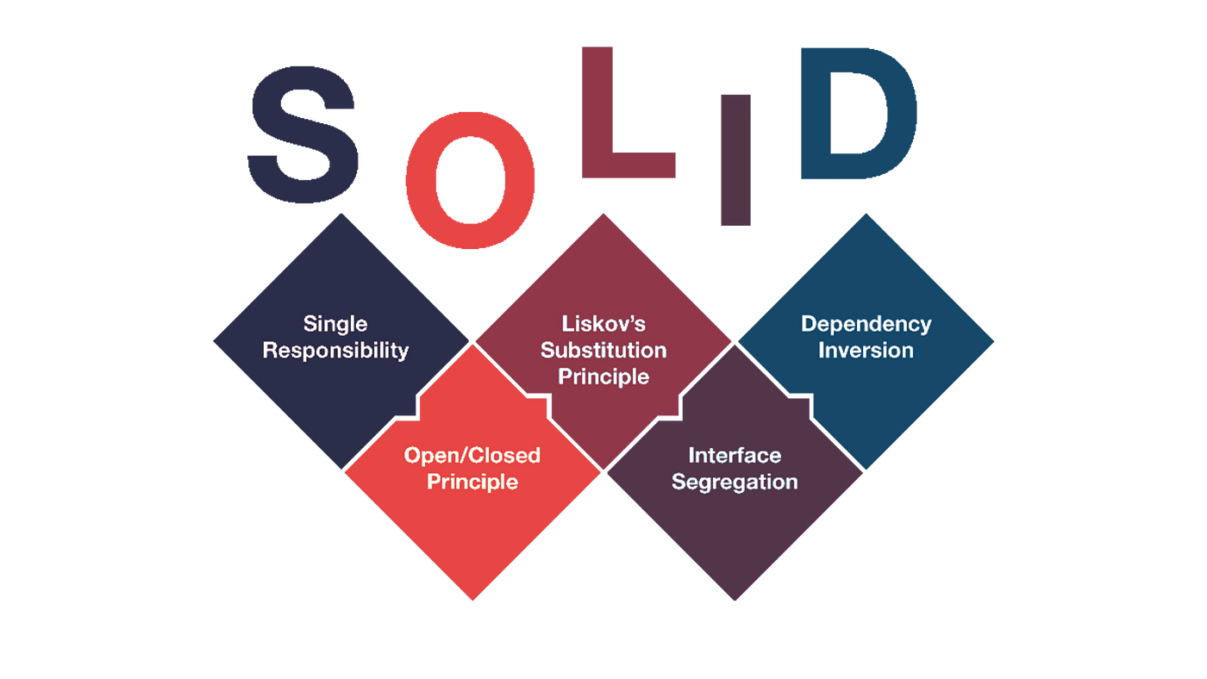
SOLID is an acronym for five principles of object-oriented programming that help engineers write maintainable, flexible, and reusable code.

Slide 12
Single Responsibility Principle (SRP)
<p> One Job per Class! </p>
A Class should have just one reason to change.
<p> In Simpler Words </p>
Each Class should have only one sole purpose and not filled with excessive functionality.
<p> Why? </p>
Less headache, easy fixes, happy life

Slide 13
Open Closed Principle (OCP)
<p> Keep it Flexible! </p>
Software entities (classes, modules, functions, etc.) should be open for extension but closed for modification.
<p> In Simpler words </p>
You should not have to rewrite an existing class for implementing new feature or additional functionality.
<p> Why? </p>
Easier to change and upgrade without breaking things.

Slide 14
Liskov Substitution Principle(LSP)
<p> Interchangeable Magic! </p>
Subclasses must be substitutable for their base classes without affecting correctness.
<p> In Simple Words </p>
This means every subclass or derived class should be substitutable for their base or parent class.
<p> Why? </p>
Reliable tests you can trust.

Slide 15
Interface Segregation Principle (ISP)
<p> Stay Specific! </p>
Clients should not depend on methods they don’t use; split large interfaces into smaller, specific interfaces.
<p> In Simple Words </p>
Interfaces should not force classes to implement what they can’t do. Large interfaces should be divided into small ones.
<p> Why? </p>
Cleaner code and no unnecessary baggage.

Slide 16
Dependency Inversion Principle(DIP)
<p> Depend on Abstractions, Not Details! </p>
High-level modules should not depend directly on low-level modules but on abstractions.
<p> In Simple Words </p>
Abstractions should not depend on details. Details should depend on abstractions.
<p> Why? </p>
Easier to change and upgrade without breaking things.

Slide 17
Makeover Time: Refactoring Fun
05
<p> It’s a little quiz time. </p>

Slide 18
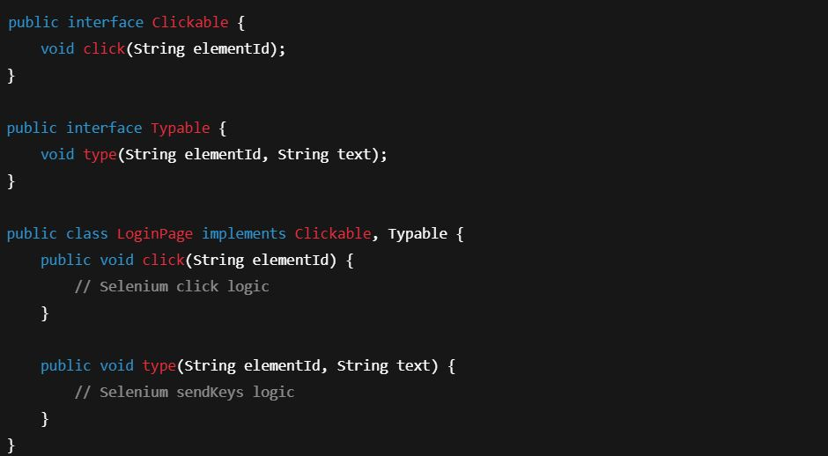
― What SOLID Principle is applied here?

Slide 19
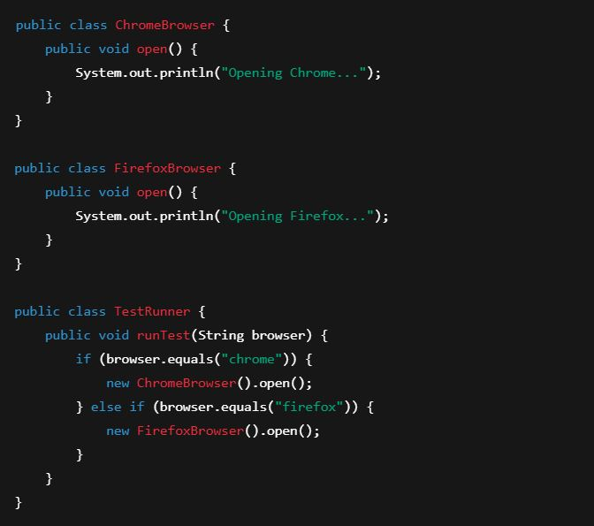
― What SOLID Principle is violated here?

Slide 20
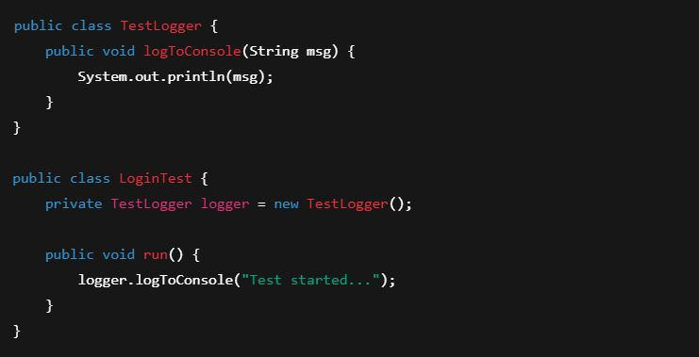
― What SOLID Principle is violated here?

Slide 21
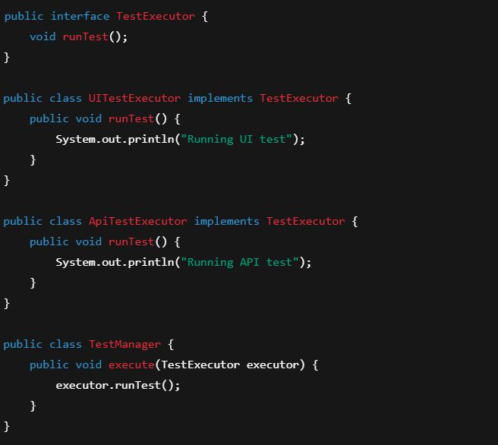
― What SOLID Principle is applied here?

Slide 22
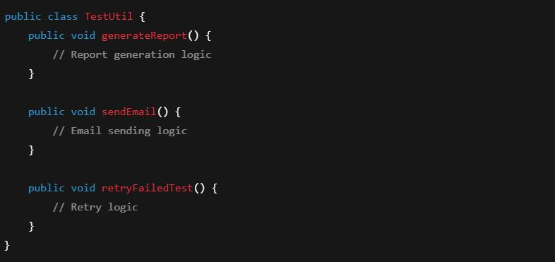
― What SOLID Principle is violated here?

Slide 23
Let's Chat : Questions and Answers
06
<p> Q & A </p>

Slide 24
Learn Items
<p> Materials </p>
https://github.com/georgetjose/SolidPrinciples
https://github.com/georgetjose/SolidPrinciplesTestExamples

Slide 25


THANK YOU!
Mail:georgeb4pc@gmail.com
LinkedIn: https://www.linkedin.com/in/george-t-jose/
Share your thoughts & feedback

